Slide 1
Inventory and VCS
Jacob Baumel

Slide 2
Inventory

Slide 3
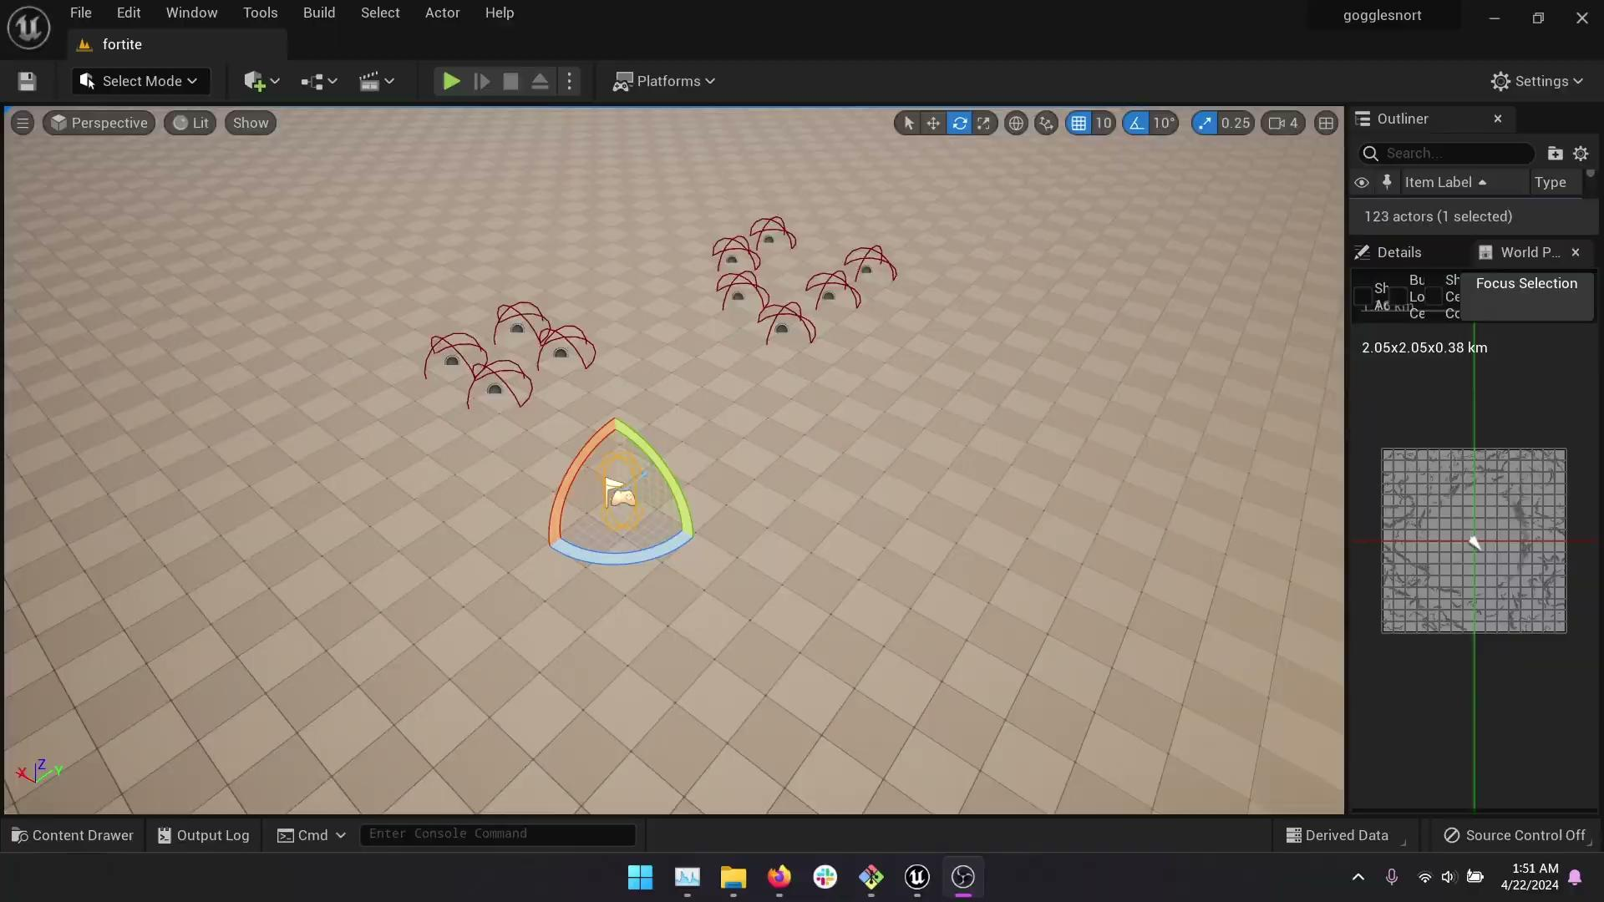
Inventory

Slide 4
Inventory Timeline
Begin helping with inventory in November
Begin working on modules system
Discover issues with inventory that warrant refactor
Remake inventory to look nicer, and to support the extra UI elements necessary
Discover issue with internal data representation, refactor to create better system
Refactor again to finalize inventory representation, and how data is stored persistently

Slide 5
Version Control

Slide 6
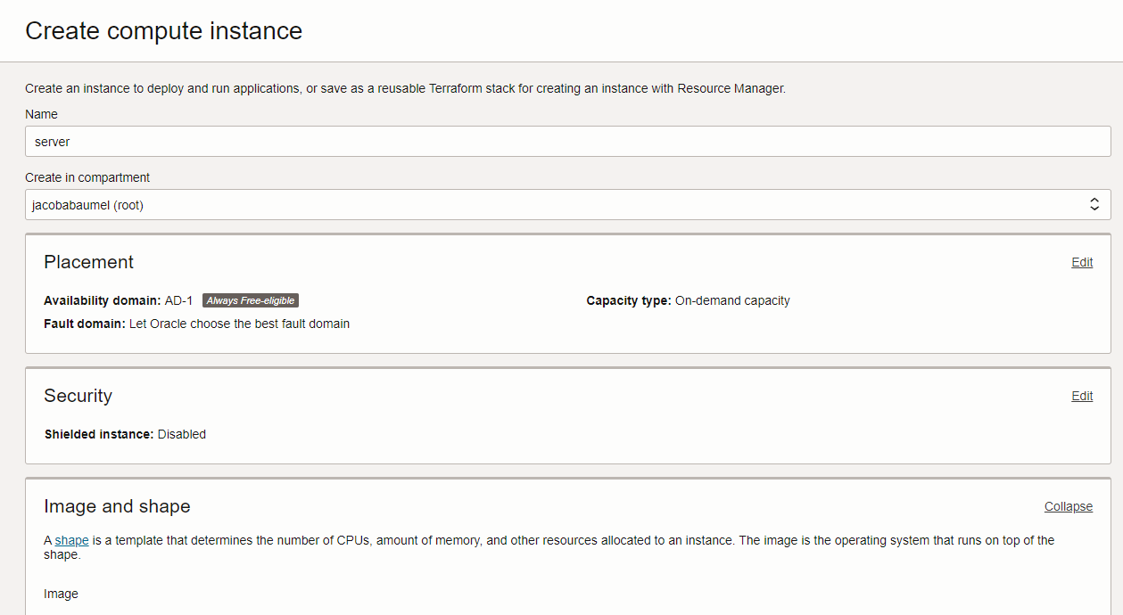
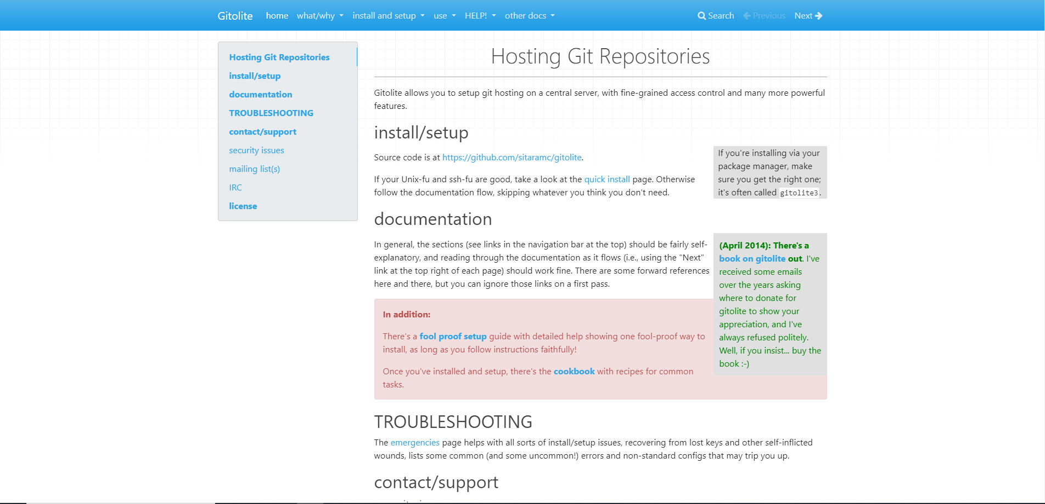
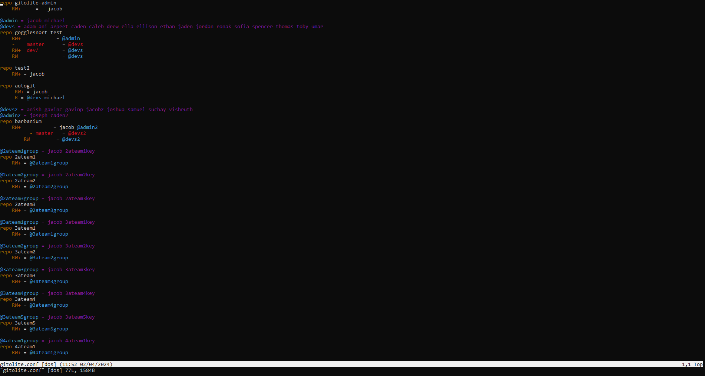
Setting up server

Slide 7
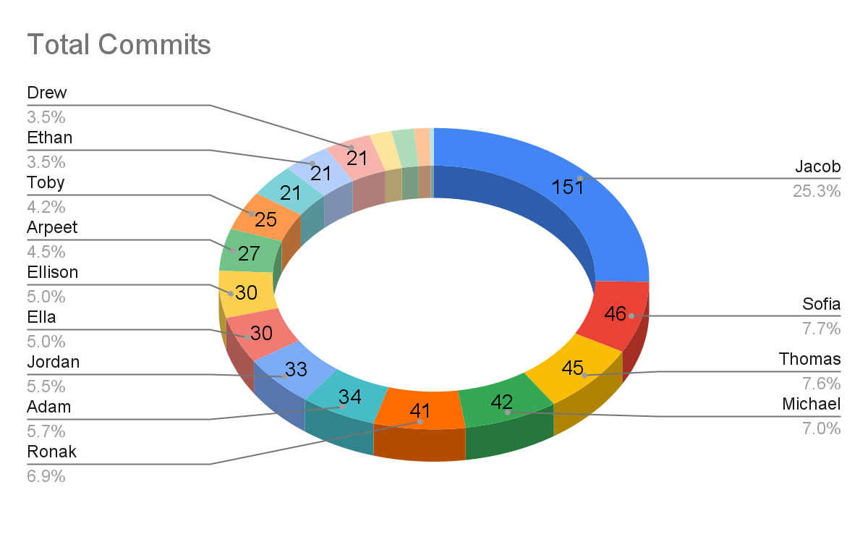
Summary Statistics
18 committers
596 total commits (at time of logging)
53 branches
7.4GB final project Size
22.5GB final repository size

Slide 8
Timeline
August:
Discuss need for version control, decide on Git
Discover Github, Gitlab, and Bitbucket are blocked on district networks
Get OCI Compute instance, set up raw git and SSH
No finer-level permissions control
RAM bottleneck when interacting with remote
Instance only has 1GB of RAM
When pulling/pushing, more RAM is needed
Create a 8GB swap partition to partially alleviate RAM issues
In-class workshop over git usage
Find gitolite, install and configure

Slide 9
Timeline
Add second VGP 2 class to server
Created tools to automate SSH key creation
Script to automatically download correct key, install into ~/.ssh directory, write SSH config file to disk, and configure Git user
After-school workshop over git usage with member of other class
Begin first few merges
Find issues with the merging process
Share merging techniques with others
Clones begin to take long
Repository size has grown to multiple gigabytes, full clones begin to take upwards of an hour
No fix
Remote server hard drive full
Created second storage block, attached over iSCSI
Moved repository onto new storage

Slide 10
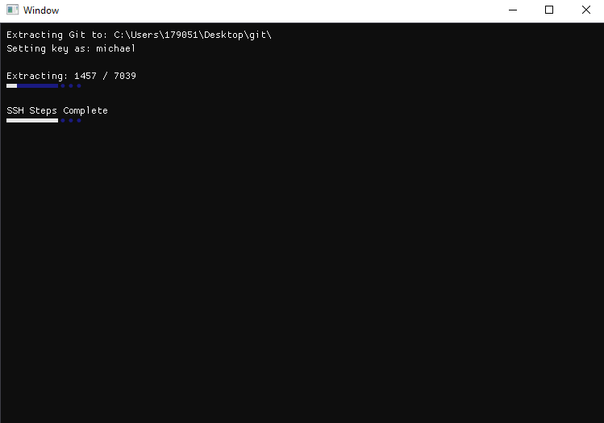
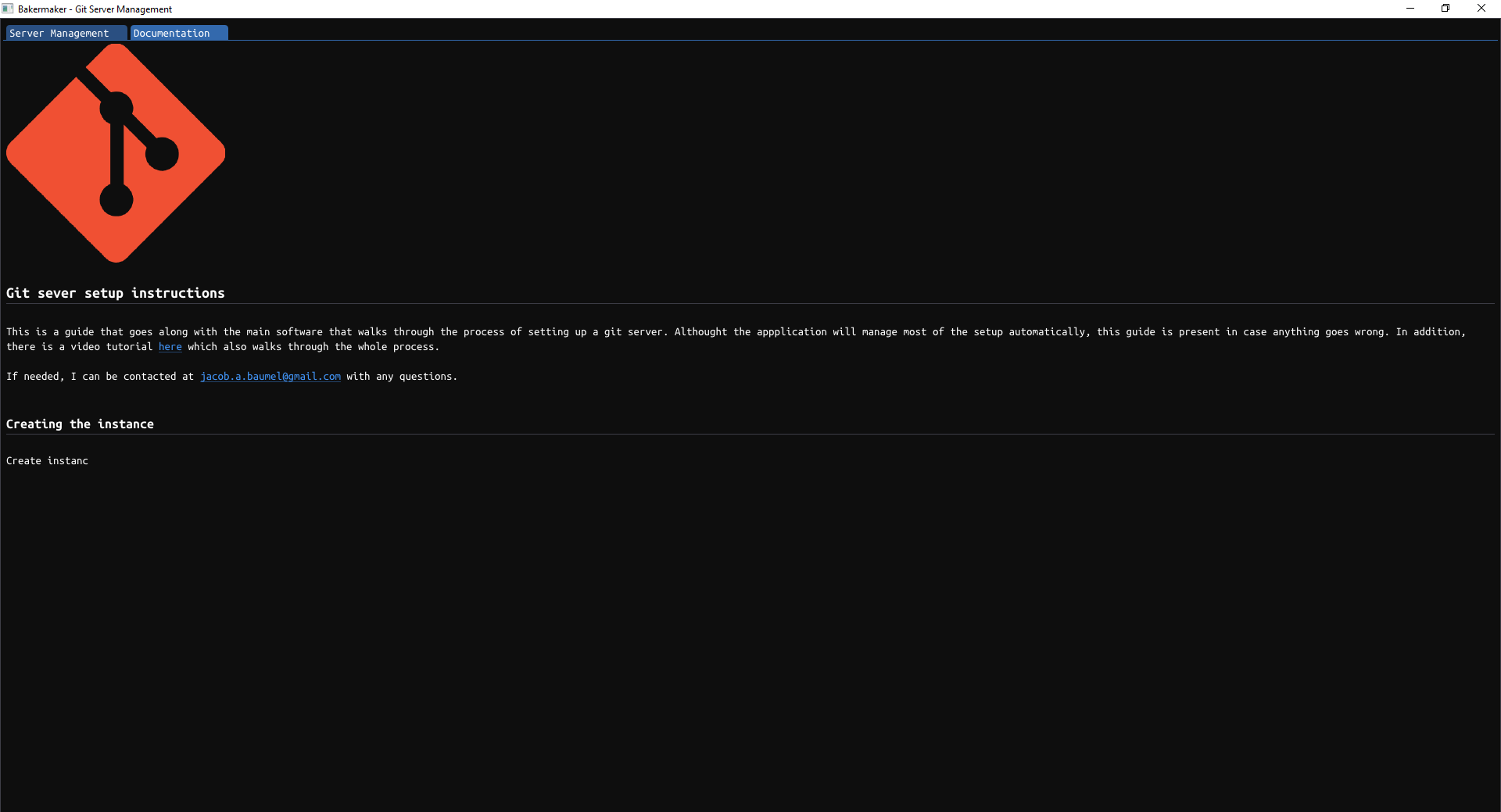
Next Year Preparedness

